Slide 1
Are You Sure
Can We Improve Child Abuse Reporting?
Why Should We?
How Might We?
C

Slide 2
Why Should We?
Emalee Flaherty explains why
Certain numbers stand out

Slide 3
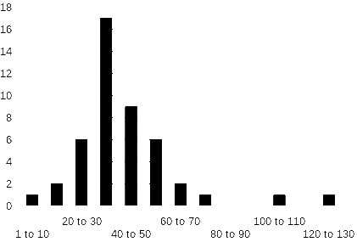
State Child Abuse Reports/1000 Children/yr.

Slide 4
Outliers?
Pennsylvania: 8 reports/1000 children/yr
District Columbia: 125 reports/1000 children/yr

Slide 5
How Sure Are You?
Thomas Fallon will explain legal probability expressions.

Slide 6
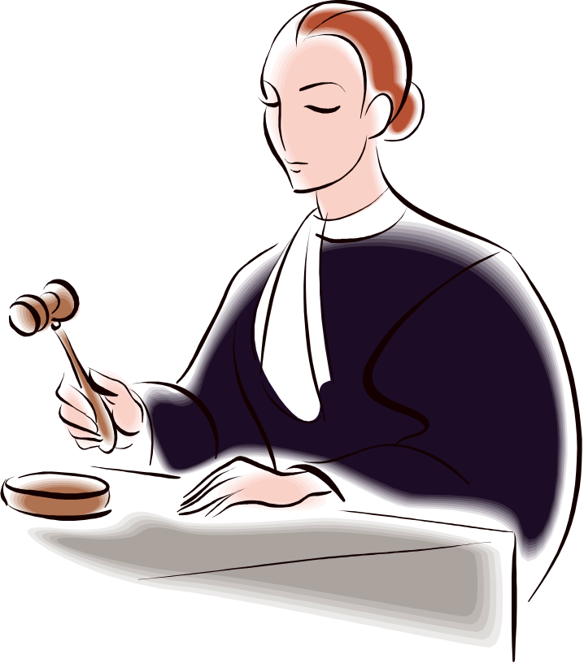
Clear and Convincing Evidence

Slide 7
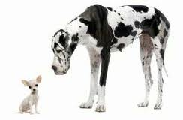
Preponderance of Evidence

Slide 8
Beyond Reasonable Doubt
Judges labor to explain this to juries using examples of difficult life decisions

Slide 9
Entry Point Expressions
Reasonable suspicion
Probable cause
Exigent circumstances
Thomas Fallon will Explain These Legal Expressions

Slide 10
Science Likes Math
Pure mathematics is, in its way, the poetry of logical ideas.
-Albert Einstein

Slide 11
Poetical Math
Yet what are all such gaieties to me
Whose thoughts are full of indices and surds?
x² + 7x + 53 = 11/3
Lewis Carroll

Slide 12
Judgement and Decision-making in Child Abuse
David Bard will explain how our statistical minds work.
Would quantitative expressions of certainty help mandated reporters?

Slide 13

Probability Expressions
Is It Quantitative?
Will It Fly In Court?

Slide 14
Science and Law
“Law has had a long and troubled relationship with science. The misuse of science within the legal realm, as well as our failed attempts to make law more scientific, are well documented. The cause of these problems, however, is less clear…”
Robin Feldman: Stanford Law Review

Slide 15
The Important Difference
Science is “never certain”, but must measure uncertainty.
Law must always make a decision.

Slide 16
Why Should We?
Emalee Flaherty

Slide 17
The Meaning of the Law
Thomas Fallon

Slide 18
A Quantitative Standard
Nationally about 22% of C.A. reports are “confirmed”
So what should be the confirmation rate:
For my County?
For my E.D.?
For me?

Slide 19
Quantitative standard
It would stimulate research and Quality Improvement.
Discontent is the first necessity of progress. (Edison)

